Slide 1
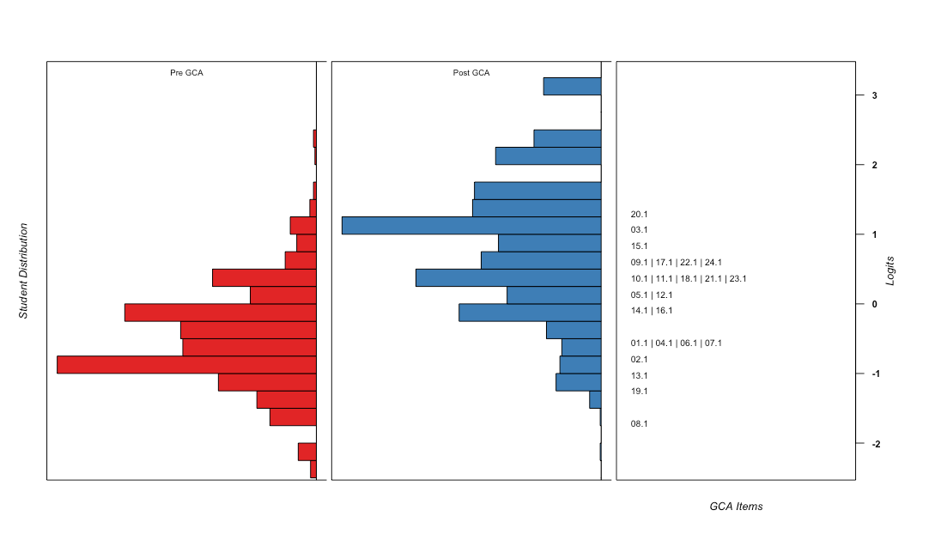
GCA Pre to Post Student Distributions with Items on Common Logit Scale
Mean Change from Pre to Post (in Post SD Units) = 1.5
Mean = -.51
SD = .58
Reliability = .63
Mean = .87
SD = .92
Reliability = .78
Harder GCA Items
Highest Scoring Class Mean
Scale Location of GCA item of average difficulty
Lowest Scoring Class Mean
Easier GCA Items
Note: Bin Width = 0.25 logits

